Slide 1

Lighting Awards
Gala Dinner
Celebrating Lighting Design Excellence & Innovation
www.iesottawa.ca

Slide 2










Thank You
2025-2026 Sponsors
Dazzle
Sparkle
Glow
For the generous support of our annual sponsors

Slide 3
Light Travels Fast
And Time Flies
Celebrate our industry, the people who make magic with it and the technological innovation that provides us with the tools.

Slide 4
Parking
Courtesy of
Did you provide your License Plate Number at the desk?

Slide 5
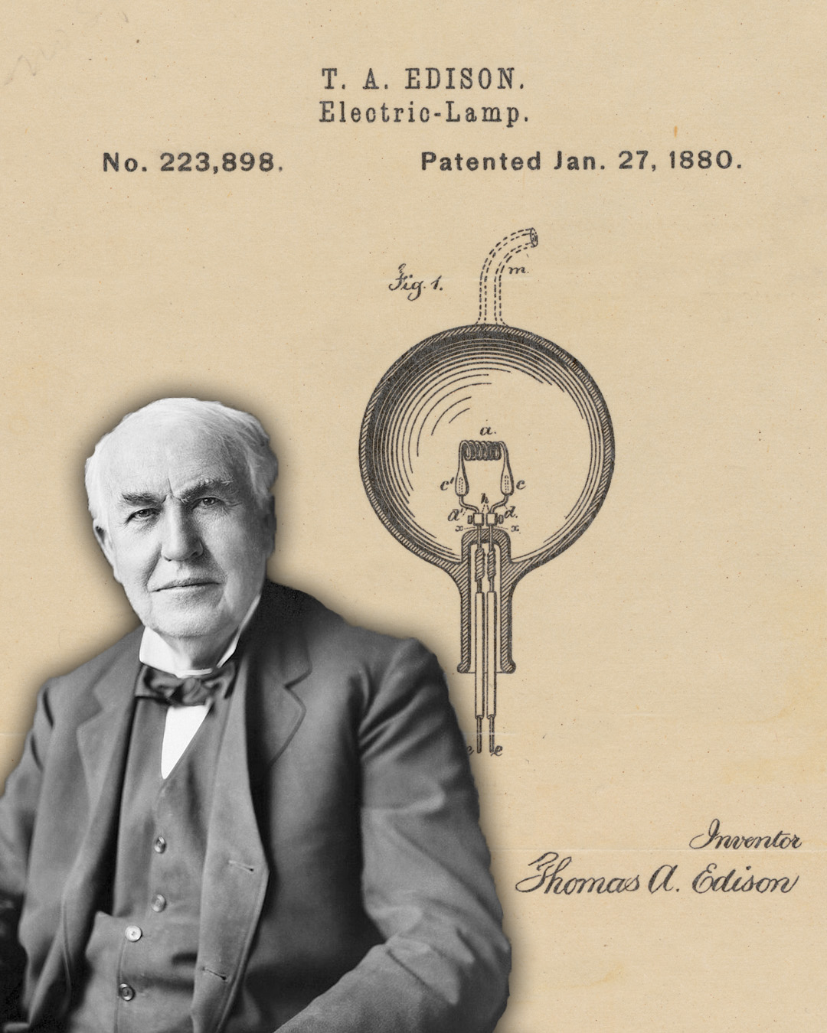
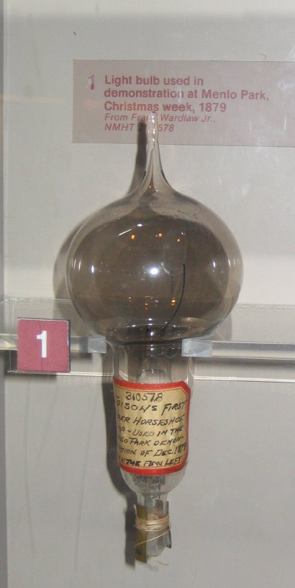

1880

Slide 6
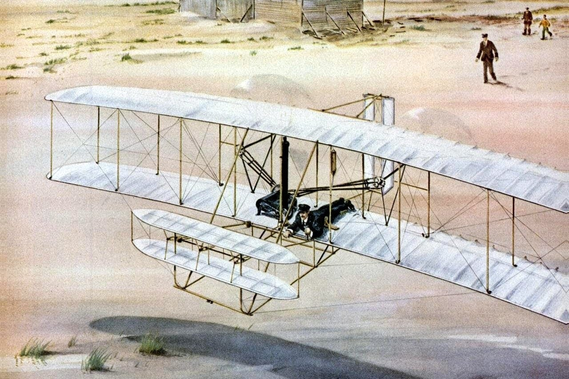
1903

Slide 7





1906

Slide 8

Appetizers
Courtesy of

Slide 9



Agenda
Cocktails & Networking
Dinner Service
5:30 – 6:30
6:30
Please Silence Your Devices
Presentations
Closing Comments
7:15 – 9:30
9:30

Slide 10

Drink Tickets
Courtesy of
Please Enjoy Responsibly

Slide 11
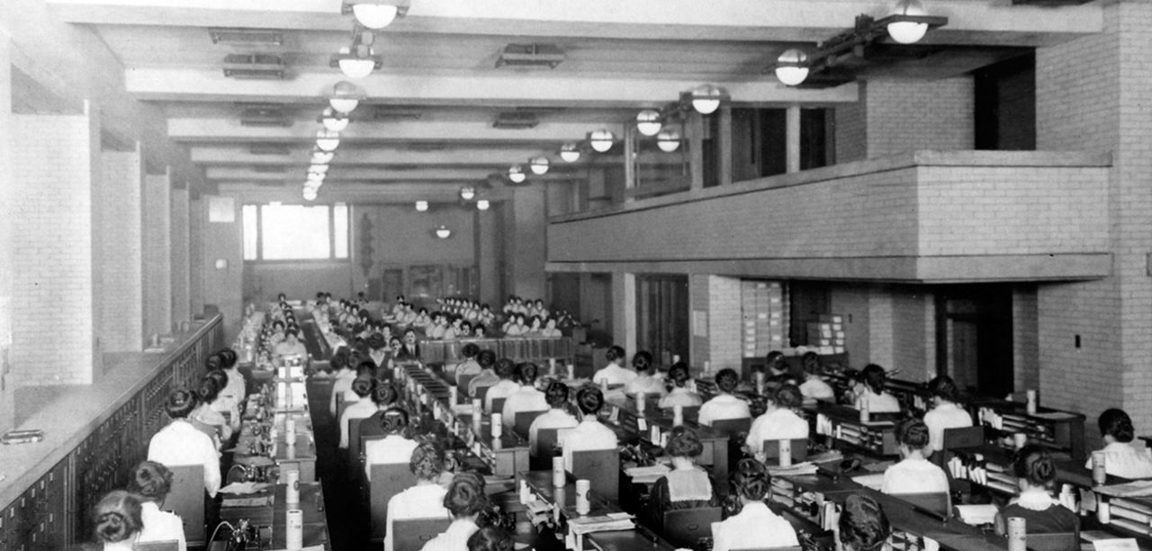
How far we have come!

Slide 12

Ottawa Section

Slide 13
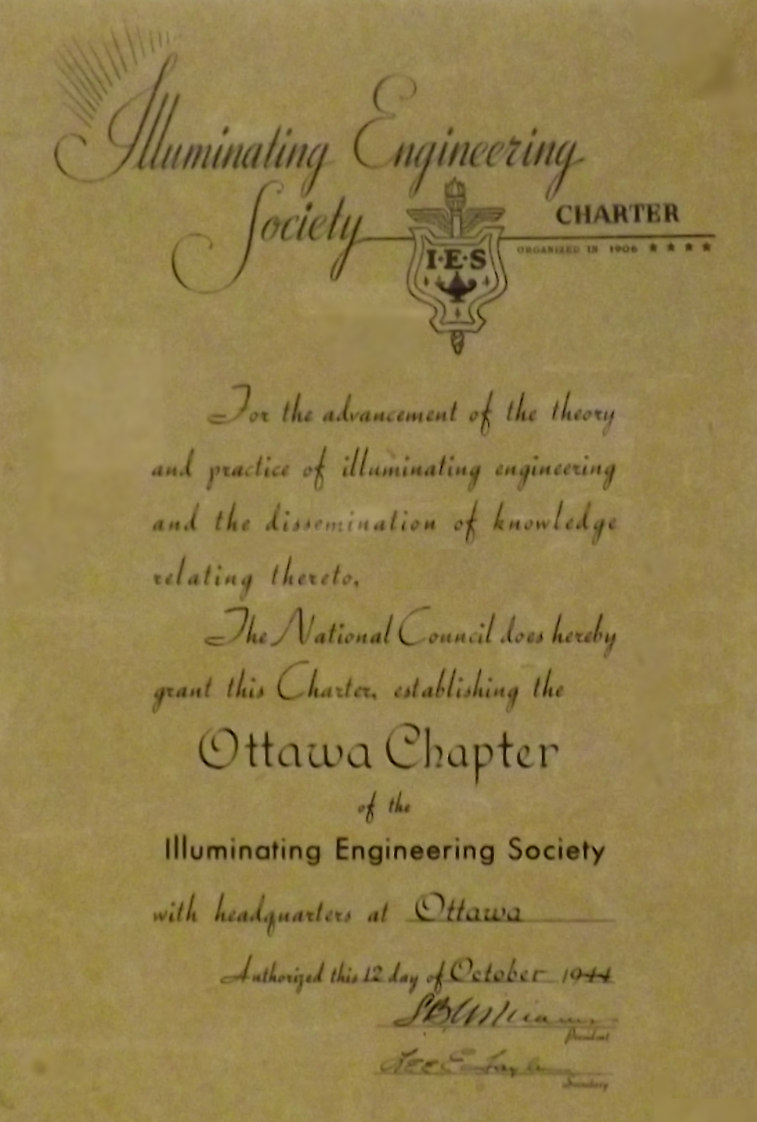
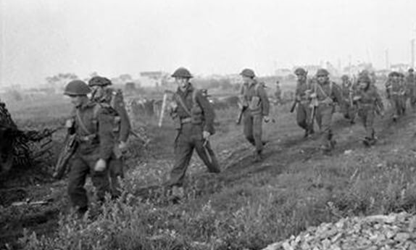
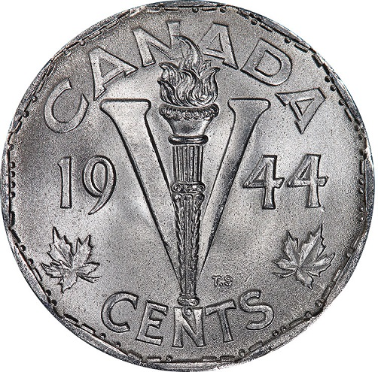
Ottawa Section
Chartered in 1944

Slide 14
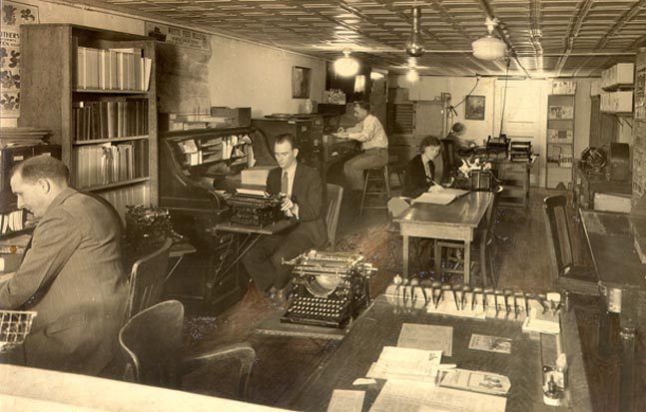
How far we have come!

Slide 15
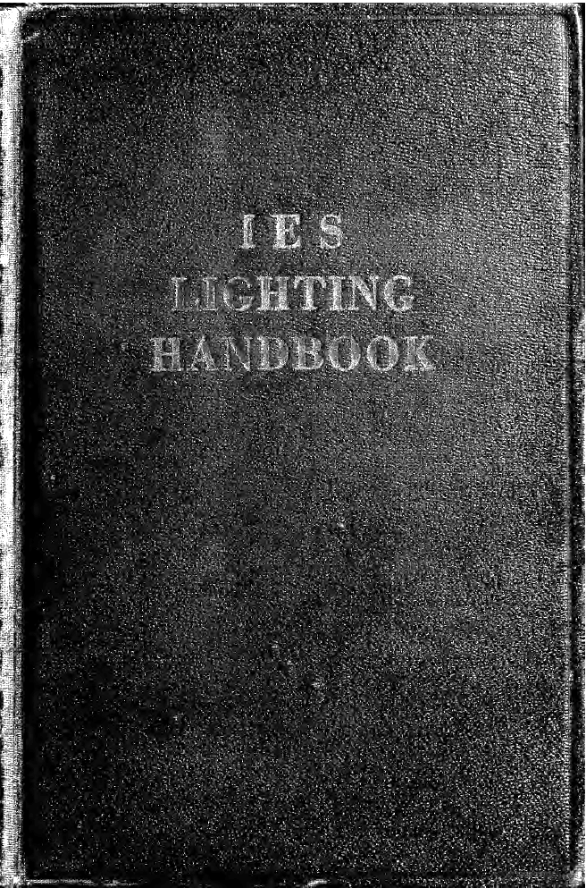

The First IES Lighting Handbook
1947

Slide 16

Wine on Tables
Courtesy of

Slide 17
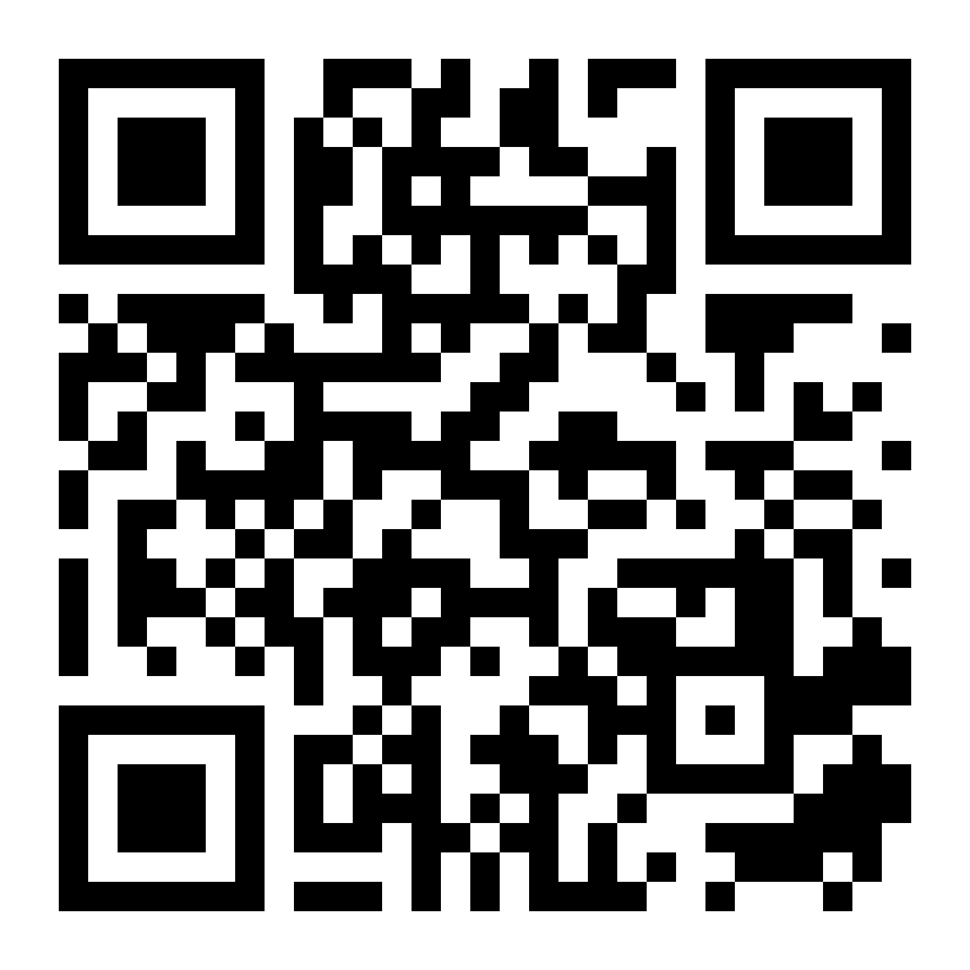
Become a Member
Scan for more info

Slide 18
“We must look for the revolutionary inventions to come—engines driven by atomic energy, rocket ships that voyage in interplanetary space, lamps that glow without heat.”
The New York Times November 24, 1936 following the demonstration of fluorescent lighting at the U.S. Patent Office in celebration of its centennial

Slide 19
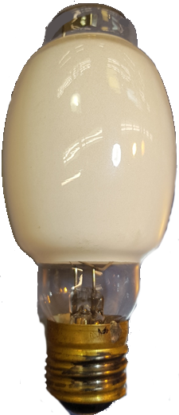
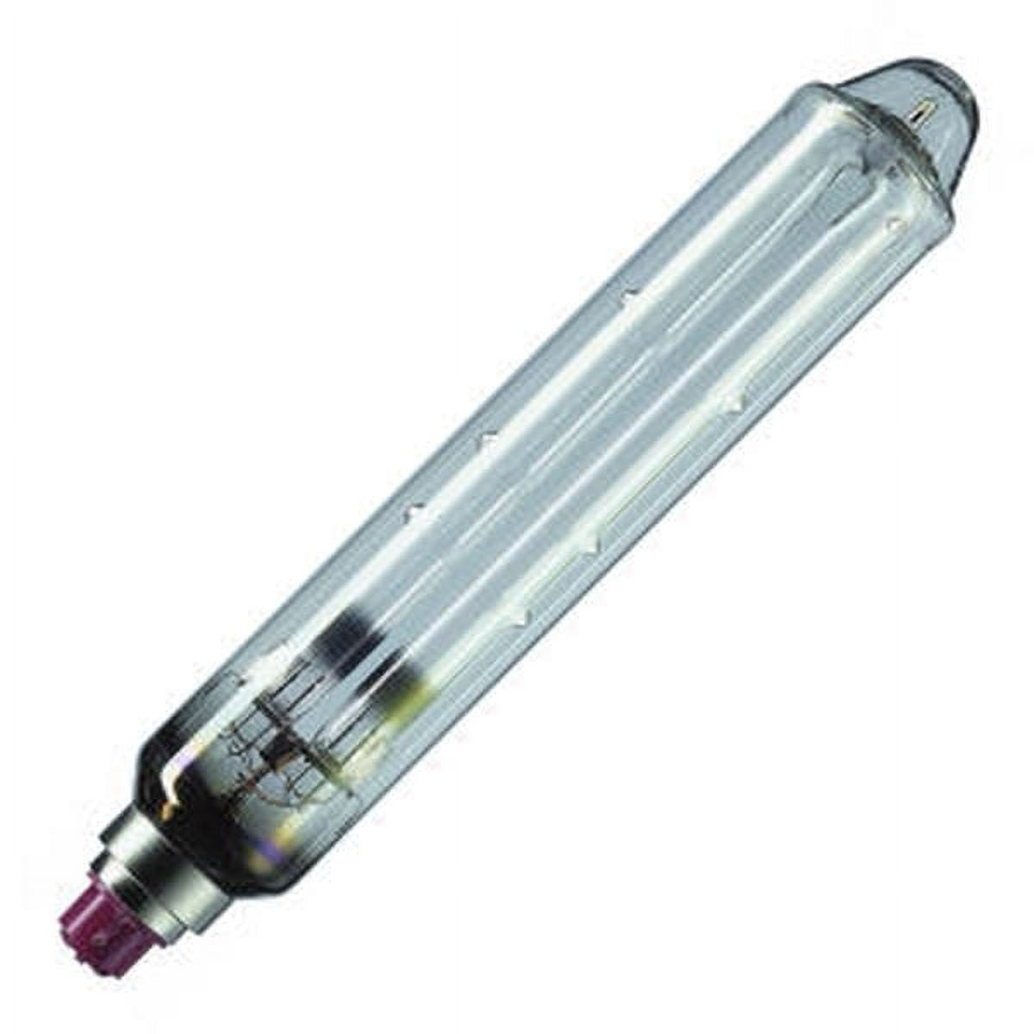
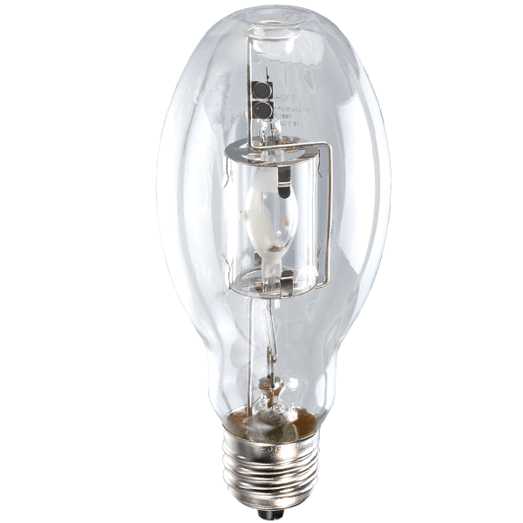
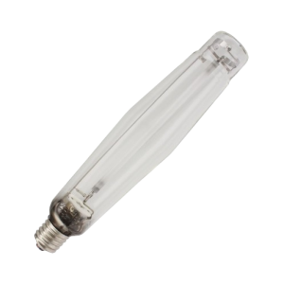
1901: Mercury Vapor Lamp
1930s: Low-Pressure Sodium
1960s: Metal Halide Lamps (MH)
1965: High-Pressure Sodium (HPS)

Slide 20
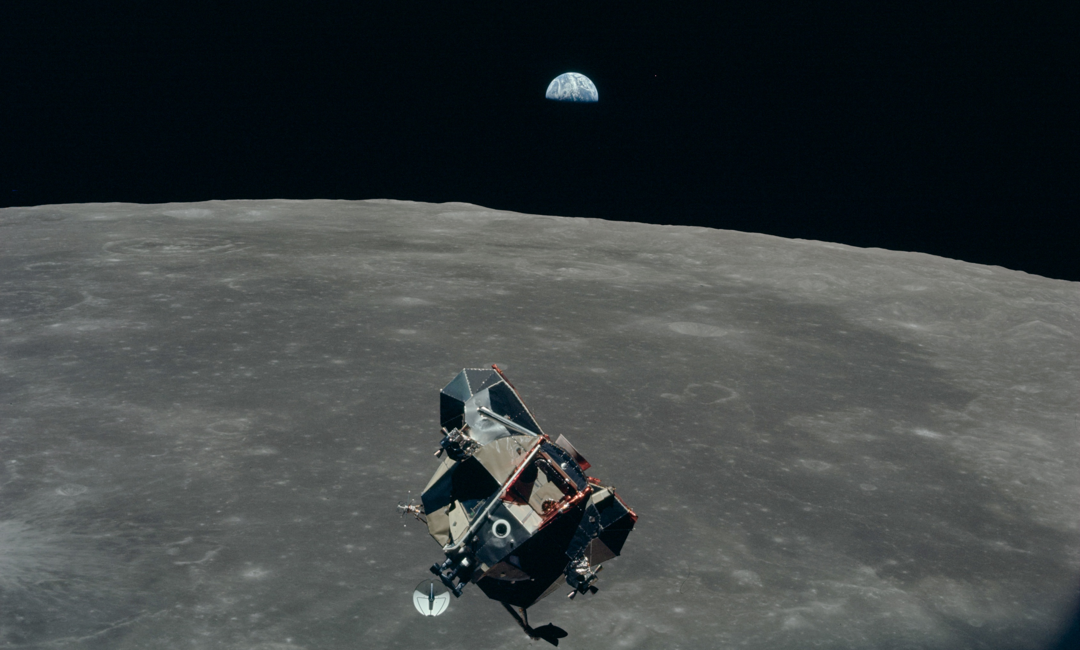
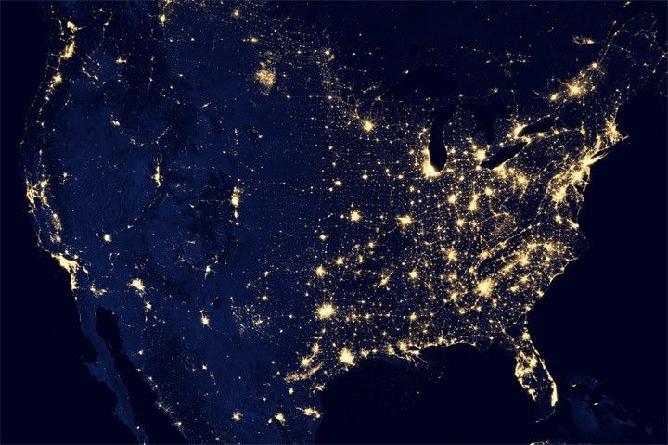
1969
That is a lot of light in the wrong direction

Slide 21
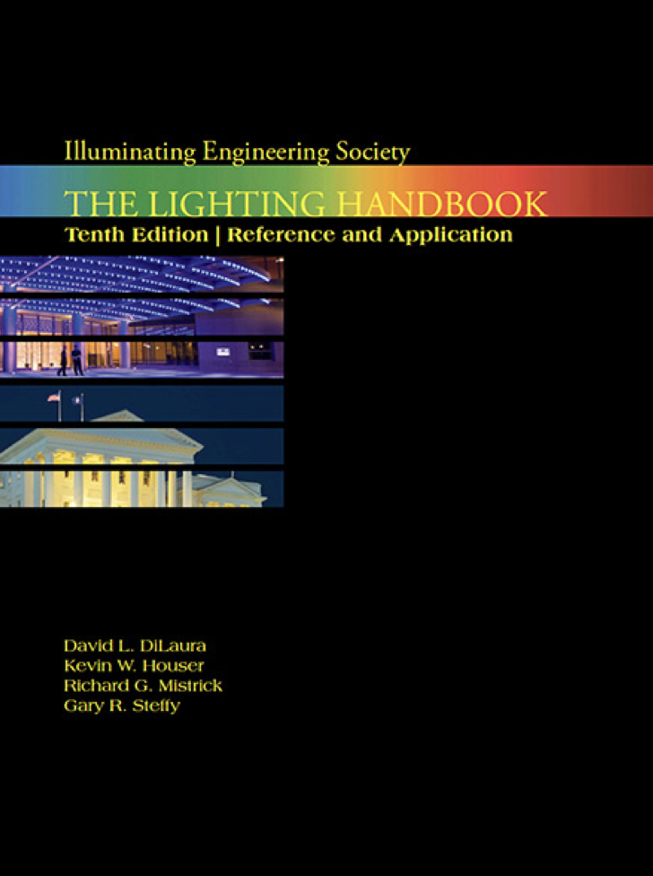
The last handbook printed
Edition 10 ©2010

Slide 22
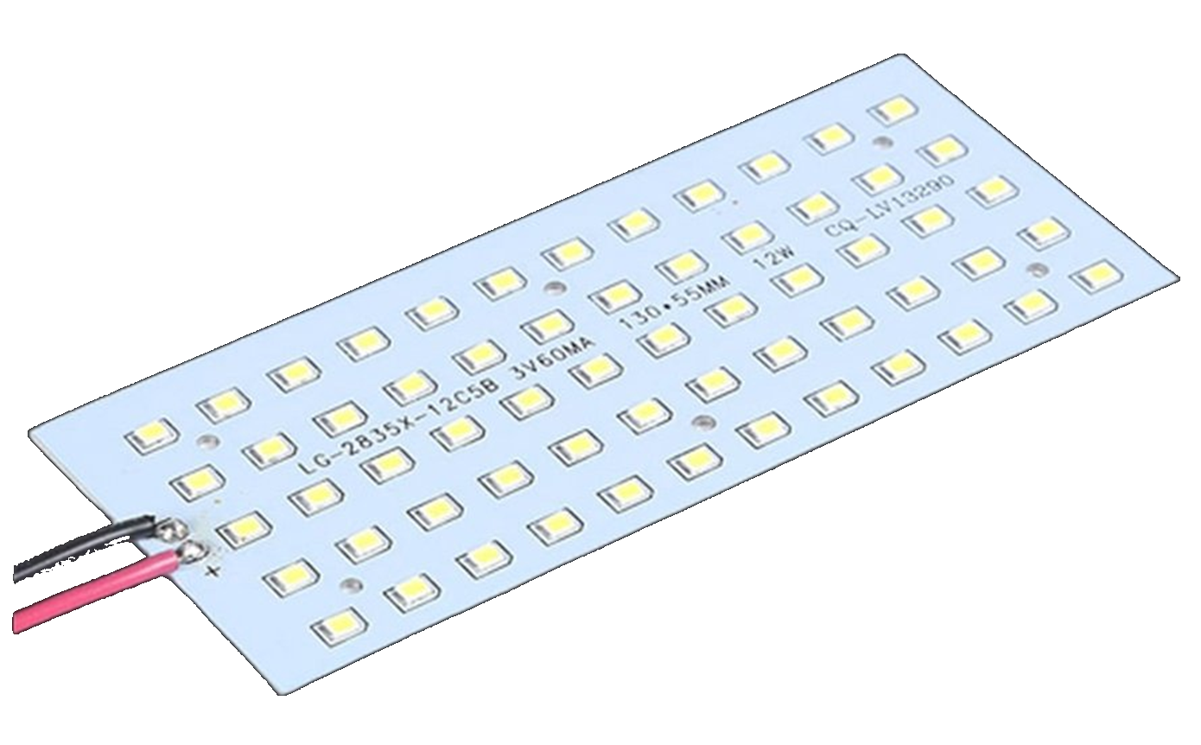
TODAY

Slide 23
Ottawa Section

